Slide 1

Microservices in production
a case study
marin.prcela@minus5.hr

Slide 2
What are Microservices?
Do you need them?
How did we do it?

Slide 3
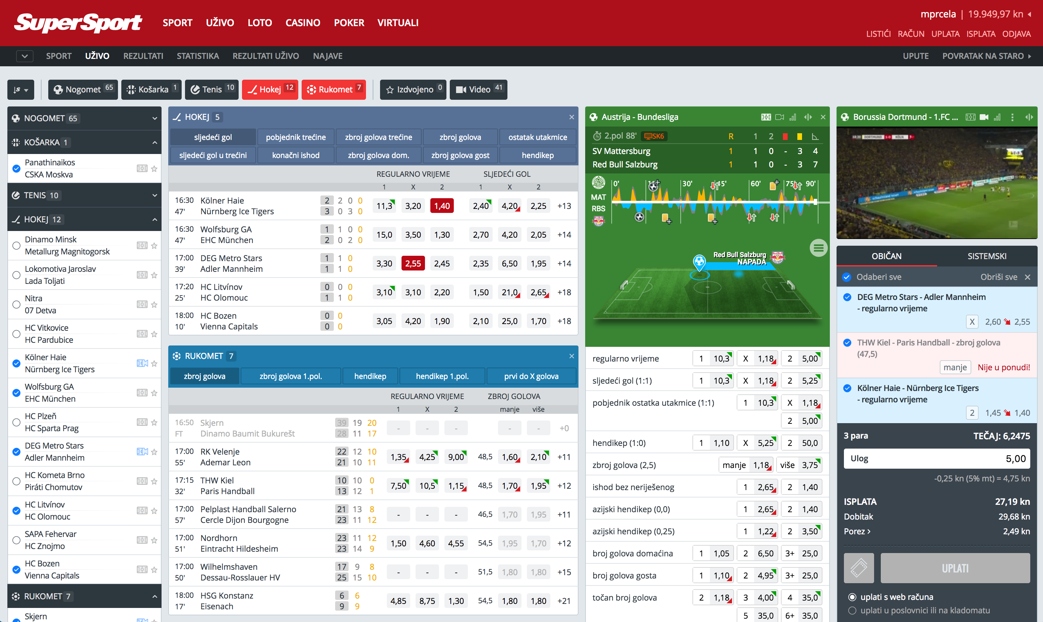

Slide 4
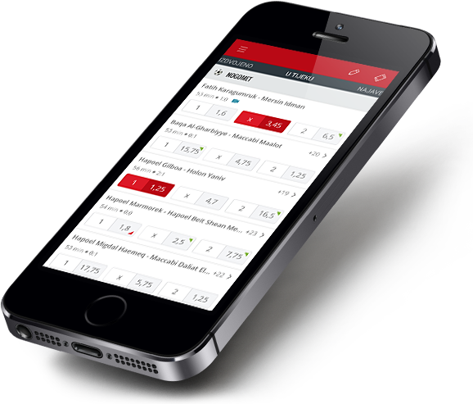
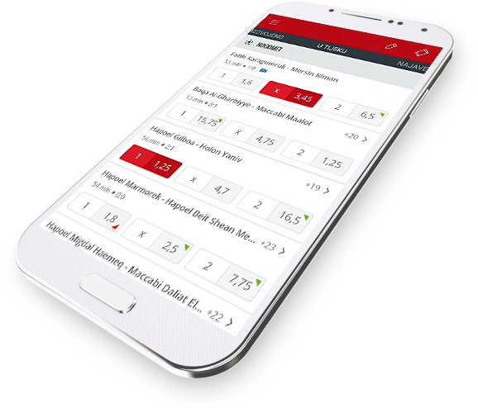

Slide 5
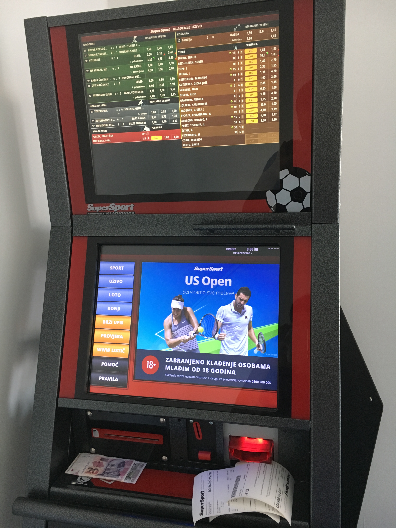

Slide 6
What are Microservices?

Slide 7
loosely coupled
business capabilities
enable continioius delivery
evolve techology stack

Slide 8
Monolith
Microservices
frontend
frontend
backend
tickets
odds
accounts

Slide 9
Do you need them?

Slide 10
Coupling
Putting network in the middle helps?
Joined data?

Slide 11


Slide 12
Latency
ticket already processed?
odds are
valid?
reserve
money
authorization?
store ticket
confirm
money
reservation

Slide 14
Scalability
tickets
odds
accounts

Slide 15
Do you need them?

Slide 16
How did we do it?

Slide 17

github.com/minus5/examples-services

Slide 18




REST
Messaging
Service Discovery
Containerisation

Slide 19
APP
HTTP
HTTP
SENSOR
WORKER
SENSOR
WORKER
APP
HTTP
HTTP

Slide 20
You are here
REST
Messaging
Service Discovery
Containerisation

Slide 21
Messaging
SENSOR
WORKER
APP
NSQ

Slide 22
Routing
pub/sub
load balancing
… and anti-patterns!

Slide 23
Edge cases
stale messages
missed messages
order of receiving

Slide 25
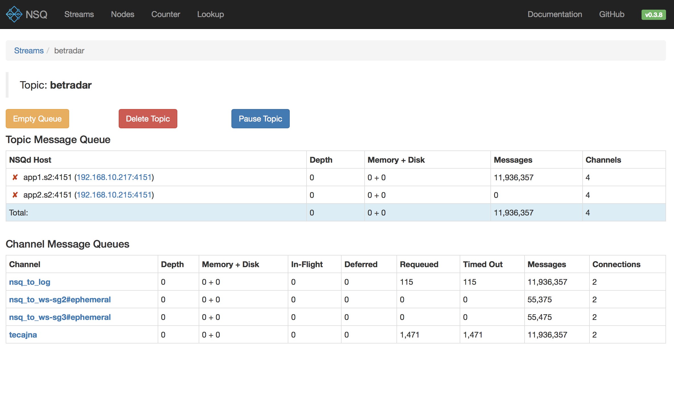

Slide 26
REST
Messaging
You are here
Service Discovery
Containerisation

Slide 27
Service discovery
name
location
health check

Slide 28
FindING service
setup Consul as DNS
poll Consul with HTTP
events from Consul
consul-template

Slide 29
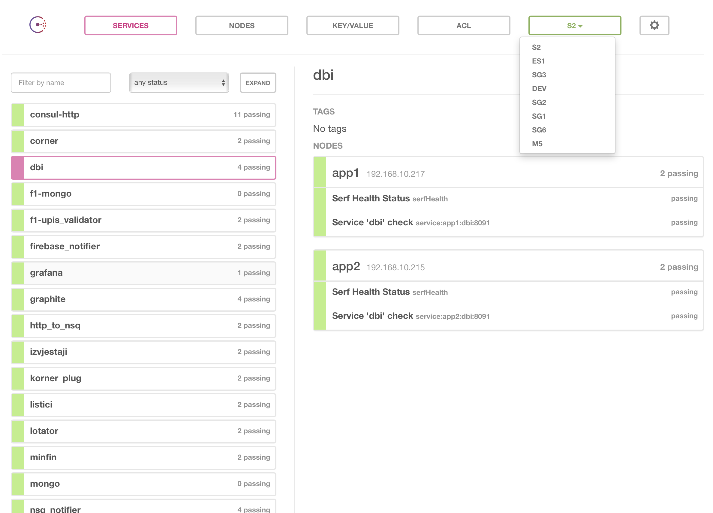

Slide 30
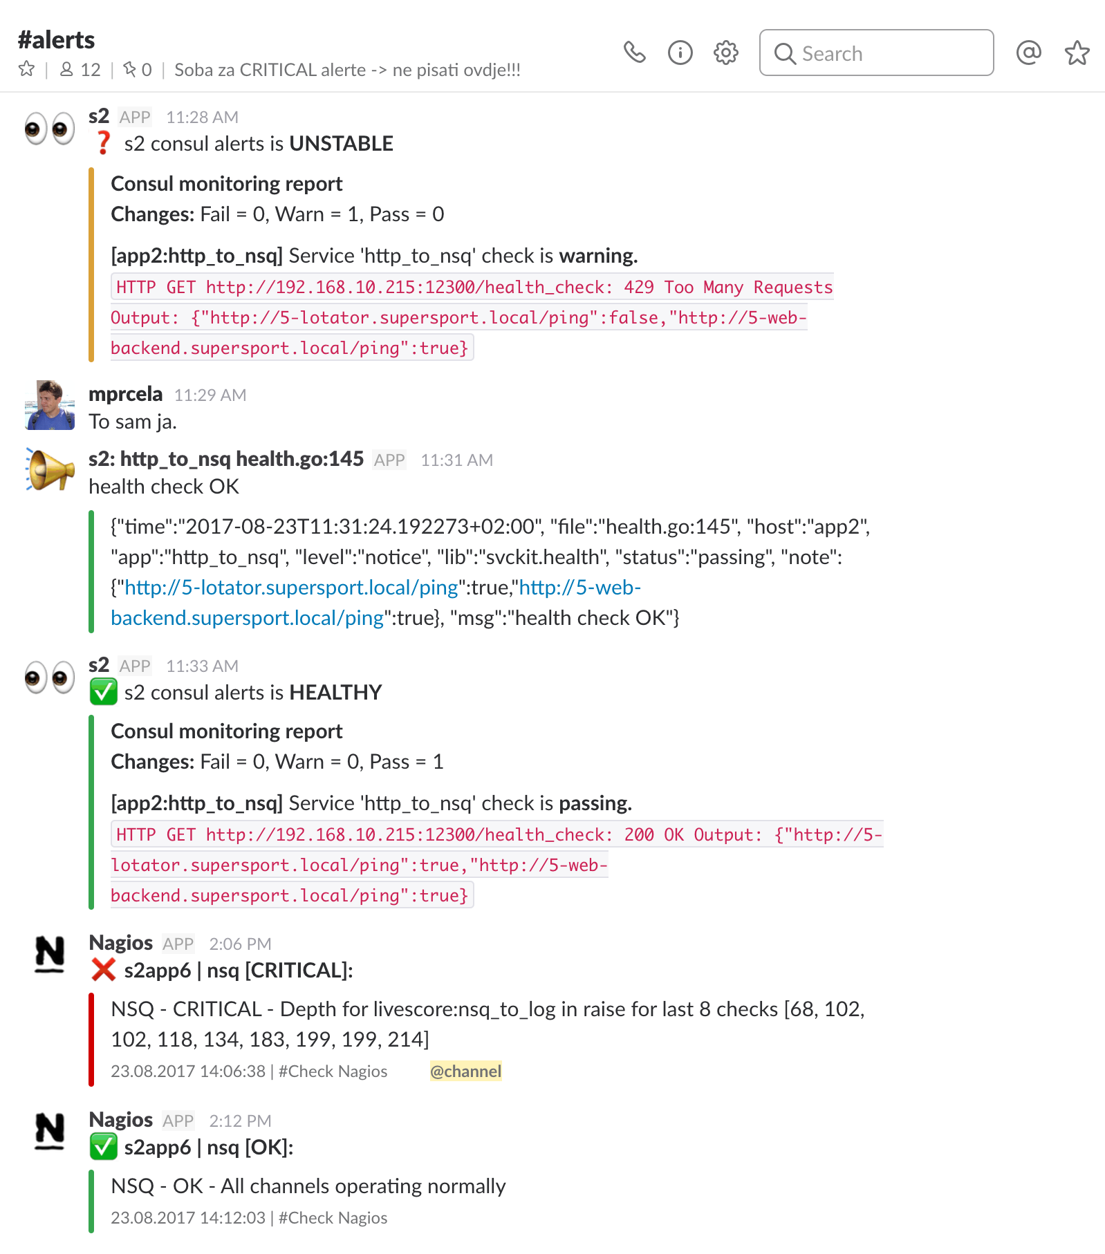

Slide 31
REST
Messaging
You are here
Service Discovery
Containerisation

Slide 32
Containerisation
recipe
image
container

Slide 33
Benefits
service management
service environment
run on my machine
everything is in the code!

Slide 34
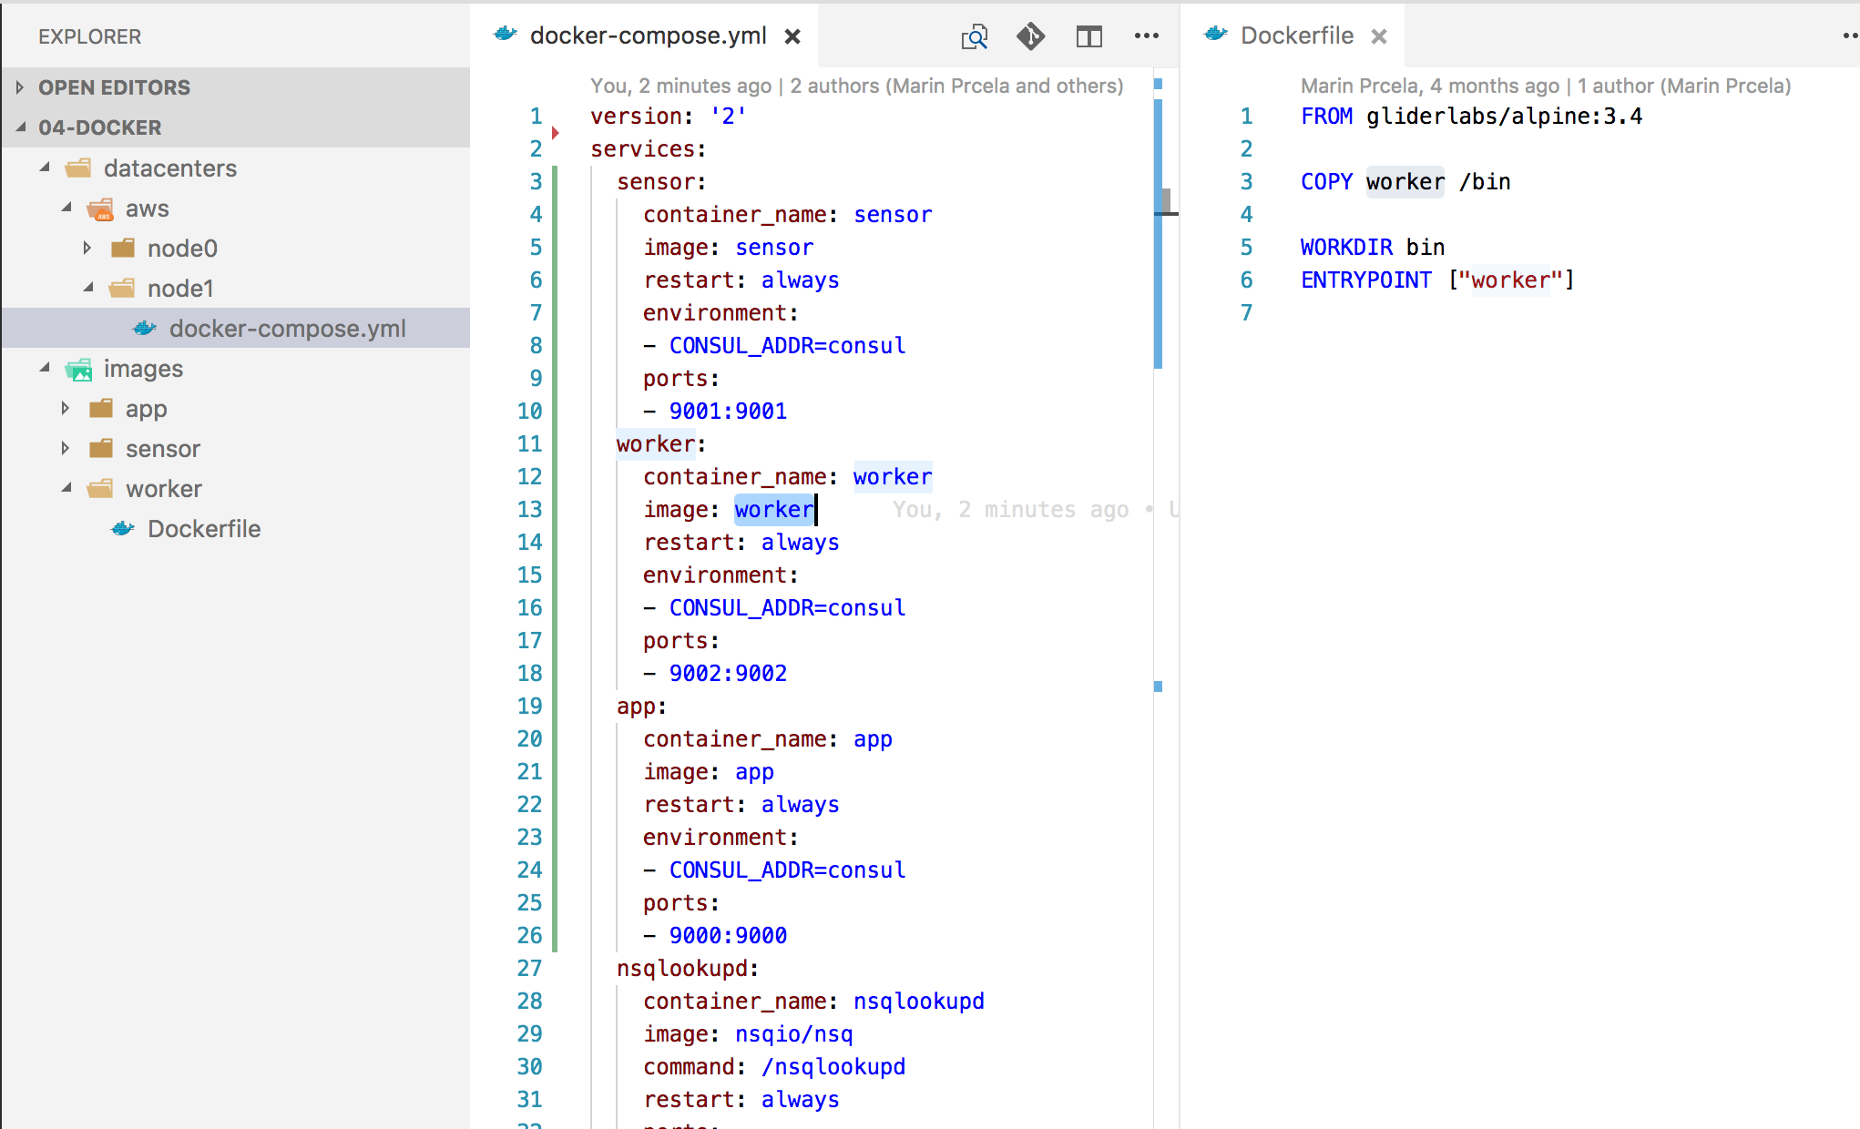

Slide 35
worker
go build
image build
registry
deployer
sensor
app
nsqadmin
logger
nsqadmin
logger
nsqadmin
logger
nsqd
nsqlookupd
nsqd
nsqlookupd
nsqd
nsqlookupd
consul
registrator
consul
registrator
consul
registrator
DEV 01
DEV 02
AWS 01
DEV
datacenter
AWS
datacenter

Slide 36
github.com/minus5/examples-services

Slide 37
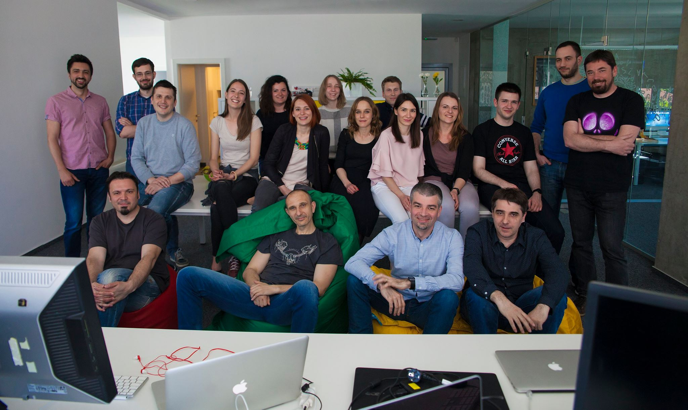
marin.prcela@minus5.hr

